Slide 1

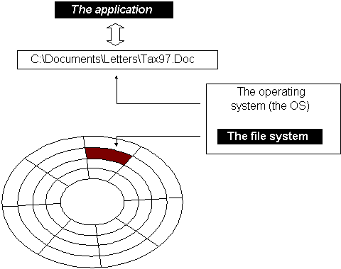
File System Forensic Analysis
File Allocation Table (FAT) File System
(FAT, FAT12, FAT16, FAT32)
1
Notes:
In this lecture, we will continue studying file system forensic analysis techniques. Today, we will study how to examine FAT File System.
However, it is worth noting many analysis techniques introduced here is applicable to other file systems as well.

Slide 2

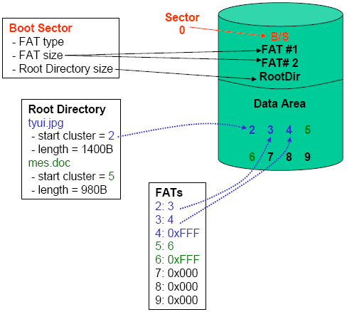


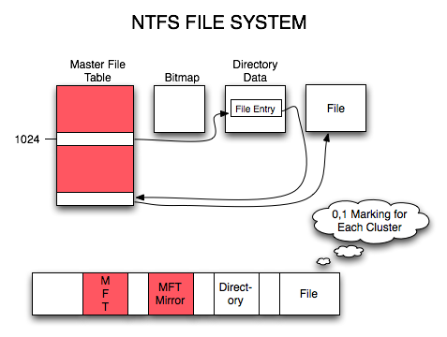
FAT
from An Investigator's Perspective
NTFS
Notes:
You have already studied file system in OS, but today we will take a look at these file systems from an investigator’s perspective.

Slide 3



Operating System (File systems) Specifications are missing!
Notes:
File system is easy?
[click]
Unfortunately, not!
[click]
Operating System (File systems) specifications are missing!

Slide 4

FAT
NTFS
…….
Notes:
There are too many file systems available today.
[click]
In this course, we will be focusing on the most common file systems encountered in forensics for Windows including FAT and NTFS.

Slide 5
File Allocation Table (FAT) File System
(FAT, FAT12, FAT16, FAT32)
5
Notes:
5
We first take a look at FAT, which has been widely used in the past as well as on lots of mobile devices now.

Slide 6




MBR
Partitions
A Partition
digital storage devices
A partition formatted with a FAT file system
6
Notes:
We are now looking at a scenario: we extract a partition, which is formatted with a FAT file system.
[click]
We want to analyze it.

Slide 7

A Short History Of The Windows File Allocation Table (FAT) File System
FAT is a proprietary computer file system originally developed by Bill Gates and Marc McDonald in 1976/1977. It became the standard file system on many operating systems, including MS-DOS and Windows (up to Windows Me). It is a quite simple and commonly used file system and is thus still supported by a large number of operating systems.
This ubiquity makes it an ideal format for floppy disks and solid-state memory cards, and a convenient way of sharing data between disparate operating systems.
It includes FAT12, FAT16, FAT32.
7
Notes:
7
FAT is a proprietary computer file system originally developed by Bill Gates and Marc McDonald.
[click]
Do you recognize this famous guy? Bill Gates
It became the standard file system on many operating systems. It is a quite simple and commonly used file system and is thus still supported by a large number of operating systems.
It includes FAT12, FAT16, FAT32.

Slide 8




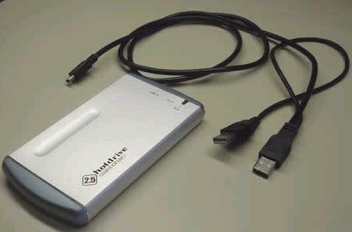
Notes:
FAT still widely used today, especially for mobile devices and removable storage devices.

Slide 9

File System
A file system (or filesystem) is a method for storing and organizing computer files and the data they contain to make it easy to find and access them.
How files are organized?
9
Notes:
Recall what is file system? It refers to how to organize files on a storage device. It is a method for storing and organizing computer files and the data they contain to make it easy to find and access them.

Slide 10
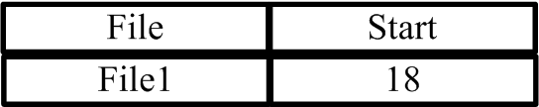
Linked Allocation - File Allocation Table (FAT)
FAT
……
Each block contains disk address of next file block
File descriptor: first block address
12
15
18
*File1: Size 3 blocks; Blocks 18, 20, 15
20
……
Structural data
10
User data
Notes:
Recall three disk space allocation methods, including contiguous allocation, Linked Allocation and Indexed Allocation.
We will review Linked Allocation.
Linked Allocation works: the directory entry contains a pointer to the starting block. Each block contains a pointer to the next block occupied by the file. The ending file block contains a special flag indicating that this is the last block for the file.
[click]
In FAT file systems, these linked information contained in each block will be saved into a table, called File Allocation Table (FAT). So the file system is named after it, also called FAT.

Slide 11



Layout of a FAT file system
The layout of the FAT file system consists of 3 physical sections:
Reserved area – for file system category
FAT area – primary and backup FAT structures
Data area – clusters used for storing file and directory content
Reserved
Sectors
FAT area
Data Area
Notes:
The layout of the FAT file system is very simple, containing 3 physical sections:
Reserved area – for file system category
FAT area – containing several identical FAT structures, one is primary FAT. Be default, there are two FAT structures in this area.
Data area – data units or clusters used for storing file and directory content

Slide 12
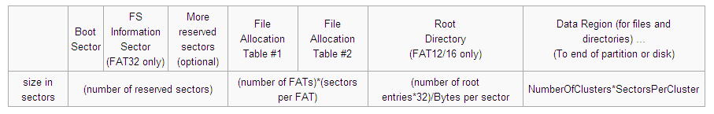
An overview of the structures in a FAT volume (partition)
Reserved sectors.
The first reserved sector (sector 0) is the Boot Sector (aka Partition Boot Record).
FAT Area
Root Directory Region
Data Region
Data Area
[1] File Allocation Table.
http://en.wikipedia.org/wiki/File_Allocation_Table#Fragmentation
Notes:
This is a detailed overview of a FAT file system. It contains 3 sections:
In the first section, Reserved area, it contains file system data. For example, the first reserved sector (sector 0) is the Boot Sector (aka Partition Boot Record). Note that we are now talking about logical partition volume address, which is an address relative to the start of the partition.
In the second section, FAT area, it contains two identical FAT structures, the first one is primary FAT. Note that the number of FAT structures may vary in different FAT volumes.
The final and third section is data area, which contains data units or clusters used for storing file and directory content. It also contains the root directory.

Slide 13
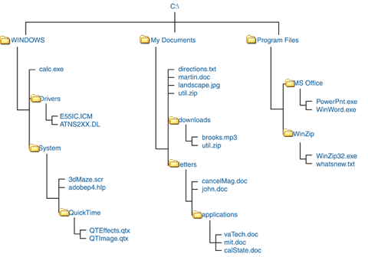
Root Directory (folder)
The first or top-most directory in a hierarchy
Notes:
A modern file system organizes its files and folders in a hierarchical folder structure. So it becomes crucial to know the first or top-most directory in a hierarchy, aka root directory or root folder.

Slide 14

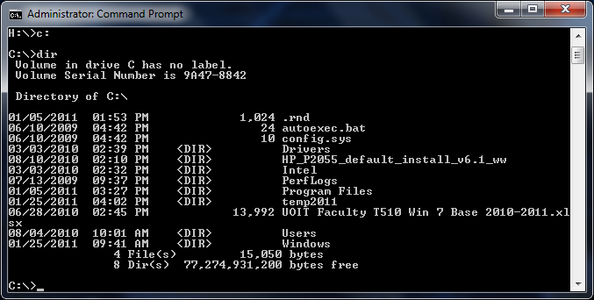
Root Directory (cont’d)
Notes:
This is an example of root folder shown in the Windows command line. As shown, the root folder contains some files and sub-folders.

Slide 15
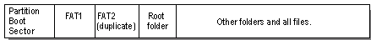
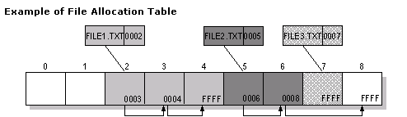
Basic layout
FAT Partition Boot Sector
Information on how to access the Volume (Bytes Per Sector, Sectors Per Cluster…)
MBR uses it to load kernel files
File Allocation Table
Two copies
Stores information about each cluster
Unused (0x0000), In Use, Bad (0xFFF7), LAST Cluster in a File (0xFFFF)
File System Category
Metadata
Notes:
Let’s take a look at basic layout of a FAT system again. It is divided into three sections. In order to locate a file, we will mainly look at the first two data structures, Partition Boot Sector and File Allocation Table.
Partition Boot Sector contains some important information like, the sector size (in bytes), data unit or cluster size in sectors. Also, MBR uses it to locate and load OS kernel files.
File Allocation Table contains entries for each cluster, and stores information about each cluster. In the example, we know the first cluster allocated to File1.txt is Cluster 2. Then, we take a look at File Allocation Table (FAT) entry #2 and find out the value stored within it is 3, which means the next (or second) cluster allocated to the file is Cluster 3. This continues until the FAT entry (FAT entry 4) corresponding to the last cluster is reached. The last FAT entry contains a special signature “FFFF”, which marks the end of the file. As such, we can find out address information for all clusters (or the chain of clusters) allocated for File1.txt, which are Clusters 2–4.

Slide 16

Partition Boot Sector Layout
Part I
FAT Partition Boot Sector
Information on how to access the Volume (Bytes Per Sector, Sectors Per Cluster…)
MBR uses it to load kernel files
File System Category
[1] Detailed Explanation of FAT Boot Sector.
http://support.microsoft.com/kb/140418
Notes:
So next, we take a look at Partition Boot Sector first.
Partition Boot Sector contains some important information like, the sector size (in bytes), data unit or cluster size in sectors. Also, MBR uses it to locate and load OS kernel files.

Slide 17

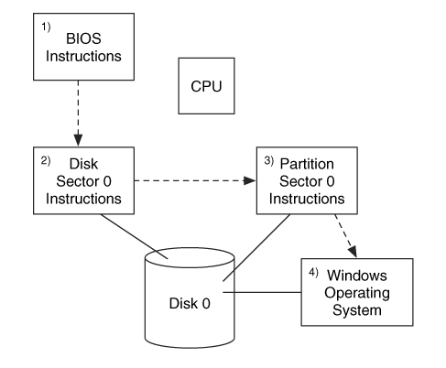

Booting Process
MBR
Notes:
Recall what you’ve learned about computer booting process. Now we are here. We assume the partition we are investigating is an active one. So your computer loads code from the boot sector of the active partition, starting your OS (e.g., Windows).

Slide 18

What does Partition Boot Sector in FAT look like?
Notes:
So what does Partition Boot Sector in FAT look like?

Slide 19
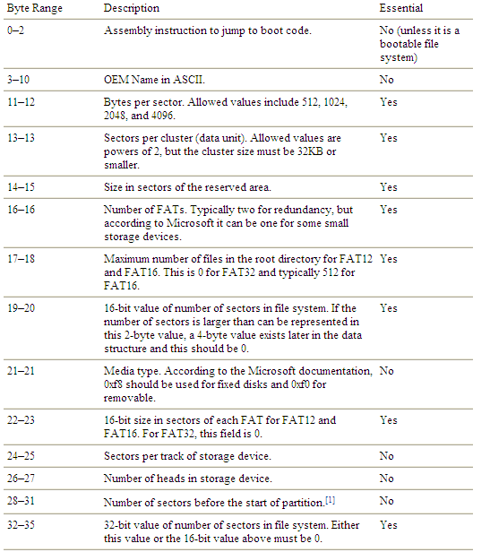
Data Structure of a Partition Boot Sector
The smallest unit of disk space that can be allocated to a file
reserved area
FAT area
Not for FAT32?
The rest is
Data area
Notes:
Partition Boot Sector contains file system data. Remember one sector is 512 bytes.
[click]
The Partition Boot Sector also defines the sector size at byte offset 11, but its value is always 512 bytes for now.
[click]
Next, it defines the size of another important concept in file system, data unit or allocation unit (sometimes known as cluster in the file systems of Microsoft Windows such as FAT and NTFS or blocks in the file systems of Linux.
A file system groups sectors into larger data blocks or units referred to as clusters, or allocation units. The file system allocates disk space in clusters, and a cluster is the smallest unit of disk space that can be allocated to a file.
Note that the smallest unit of space on the hard disk that any software program can access is a sector, which usually consists of 512 bytes.
[click]
As mentioned, Partition Boot Sector contains file system data. It means we can figure out the locations of other important areas and data structures. Now, we look at the field at byte offset 14, which shows the size of the reserved area. Also, the reserved area starts from the begin of the partition. So we now know the location of the reserved area.
[click]
Next, let’s figure out the location of the FAT area. In doing so, we need to inspect two fields to know the number of FAT structures and the size of one FAT structure. Specifically, we look at the field at byte offset 16 for the number of FAT structures, and the field at byte offset 22 for the size of one FAT structure.
[click]
But this is only for FAT12/FAT16, but for FAT32, which will be detailed later.
[click]
The rest of partition space is Data area.
As mentioned before, a modern file system including FAT file system organizes its files and folders in a hierarchical folder structure. So it becomes crucial to know the first or top-most directory in a hierarchy, aka root directory or root folder.
Note that by design, the root directory in FAT12/FAT16 immediately follows FAT area, which means it is located right behind these FAT tables.
Also, we inspect the field at byte offset 17, we know the directory can contain how many files or sub-folders. One directory entry represents one file or sub-folder. We also know that by design, each directory entry has 32 bytes. So we know the size of the root directory in FAT12/FAT16. So we know its location, but is only for the root directory in FAT12/FAT16.
You may be wondering what happened to the root directory in FAT32, which will be detailed later.

Slide 20


I. Layout of a FAT file system
Data Structure of a Partition Boot Sector (cont’d)
Reserved
Sectors
FAT area
Data Area
Not for FAT32?
Maximum number of files (entries) in the root dir for FAT12/16. (Not for FAT32)
The first or top-most directory in a hierarchy
II. root directory
Notes:
So we are able to figure out the layout of a FAT file system by inspecting the first 36 bytes of a Partition Boot Sector.
However, regarding the root directory, we only know maximum number of files (entries) in the root directory for FAT12/16, but not for FAT32. In other words, we still don’t know how big the root directory in FAT32 is.

Slide 21
Data Structure of a Partition Boot Sector (cont’d)
byte range | Description | Essential
0-35 | See Table in the previous slide | Yes
36-36 | BIOS INT 13h drive number | No
37-37 | Not used | No
38-38 | Extended boot signature to identify if the next three values are valid. The signature is 0x29 | No
39-42 | Volume serial number, which some versions of Windows will calculate based on the creation date and time | No
43-53 | Volume label in ASCII. The user chooses this value when creating the file system | No
54-61 | File system type label in ASCII. Standard values include "FAT", "FAT12", and "FAT16,", but nothing is required. | No
62-509 | Not used | No
510-511 | Signature value (0xAA55) | No
Data structure for the remainder of the FAT12/16 boot sector.
Notes:
Also, you may notice that the final two bytes of a Partition Boot Sector are 0xAA55.

Slide 22
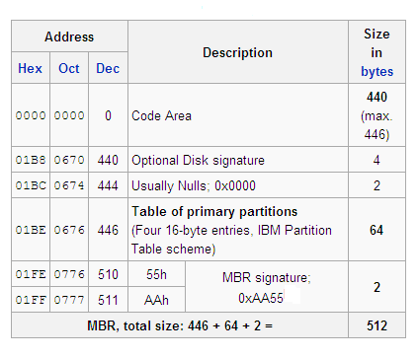
Data Structure of a MBR
[1] Master boot record. http://en.wikipedia.org/wiki/Master_boot_record
Notes:
Looks familiar? Recall the data structure of a MBR. The final two bytes of the 512-byte MBR are also 0xAA55, called MBR signature. Note that the 2-byte numbers are stored little endian (low order byte first).
So you should realize that if the last two bytes of a sector is 0xAA55, it doesn't mean that it must be a MBR.

Slide 23

Data Structure of a Partition Boot Sector (cont’d)
FAT area
Not for FAT32?
Notes:
As we just know, by looking at the first 36 bytes of a Partition Boot Sector, we can only figure out the number of FAT structures and how big for each FAT structure in sectors. In other words, we figure out the location of FAT area.
[click]
But, the size information for the FAT structure is only for FAT12/16, but not for FAT32. unfortunately, FAT32 is the one widely used today. So we have more to do.

Slide 24
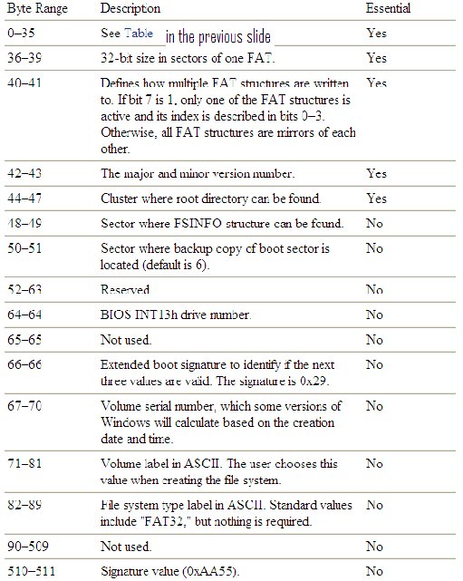

Data Structure of a Partition Boot Sector (cont’d)
FAT area
Data structure for the remainder of the FAT32 boot sector.
Notes:
So we have to check the Partition Boot Sector beyond its first 36 bytes.
[click]
Particularly, we look at the field at byte offset 36, and can find out the size of a FAT structure in sectors. Plus, we already know the number of FAT structures from byte offset 16. So we know the location of FAT area.
[click]
In FAT32, the root directory is treated like a regular file. It means the first cluster can be found in a Partition Boot Sector, particularly, in the field at byte offset 44. Afterwards, we take a look at the corresponding FAT entry and find out the value stored within it, which is the next (or second) cluster allocated to the root directory. This continues until the last FAT entry containing a special signature, which marks the end of the root directory. As such, we can find out address information for all clusters (or the chain of clusters) allocated for the root directory.
So we know the location of the root directory.
Because of this design, it is obvious that in FAT32, the root directory can be located anywhere in the Data Area.
[click]
Also, FAT32 introduces a backup copy of Partition Boot Sector, which can be found out in the field at byte offset 50.
This redundancy increases the reliability and robustness of the FAT32 file system. This is because Partition Boot Sector is an important data structure for the FAT file system. If it is damaged, the file system becomes unusable. A backup copy can come into play if the primary one is damaged so the file system can be repaired.
[click]
Also, a new data structure is introduced in FAT32, called FSINFO, which will de detailed later.

Slide 25

Data Structure of a Partition Boot Sector (cont’d)
There are some differences in the layout of Partition Boot Sector among the different versions of FAT.
Notes:
In summary, you should now observe that there are some differences in the layout of Partition Boot Sector among the different versions of FAT.

Slide 26
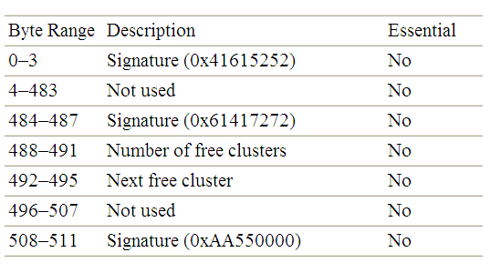
FAT32 FSINFO
Data Structure of a Partition Boot Sector (cont’d)
Data structure for the FAT32 FSINFO sector
Notes:
As mentioned, an example of difference is FAT32 has a FSINFO in the Reserved area. It is very useful.
[click]
For example, there is one field at byte offset 488, which indicates the number of free clusters or free space in the FAT file system. It means you can easily check free disk space in a FAT32 file system.
[click]
Another very useful field is located at byte offset 492, which indicates the next free cluster.

Slide 27

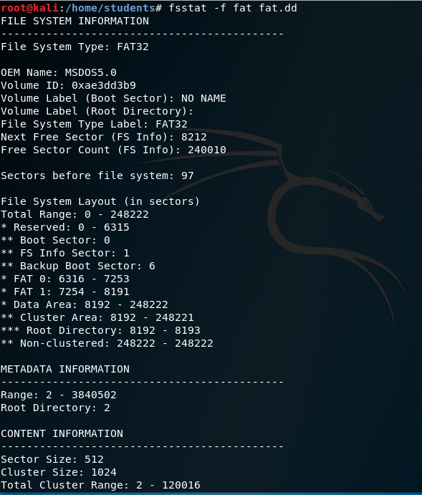
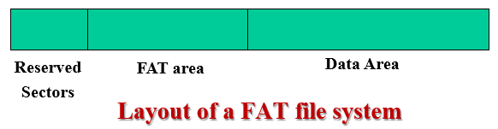
Reserved Sectors
FAT area
Data area
Notes:
This is an example output of the fsstat tool for a FAT file system.

Slide 28
Root Folder (Root Directory )
Part II
The first or top-most directory in a hierarchy
Notes:
As mentioned, a modern file system organizes its files and folders in a hierarchical folder structure. So it becomes crucial to know the root directory or root folder.

Slide 29
FAT: Root Folder (Root Directory )
Part II
file
Entry 0
folder
Entry 1
Entry 2
……
……
Notes:
Next, we take a look at how a root directory or root folder is organized. The root directory contains many entries.
Each entry represents a file or a subfolder.

Slide 30
FAT: Root Folder (cont’d)
An entry for each file or folder in root
Entry points to Starting Cluster
For each file or subfolder following information
Name, Attribute, Create Time, Create Date, Last Access Date, Last Modified Date/Time, Starting Cluster Number, File Size
File name
Metadata
Notes:
A root directory entry corresponds to a file or sub-folder in root
The directory entry contains the address of starting cluster allocated to the file. Specially, it includes the following information:
Name, Attribute, Create Time, Create Date, Last Access Date, Last Modified Date/Time, Starting Cluster Number, File Size

Slide 31
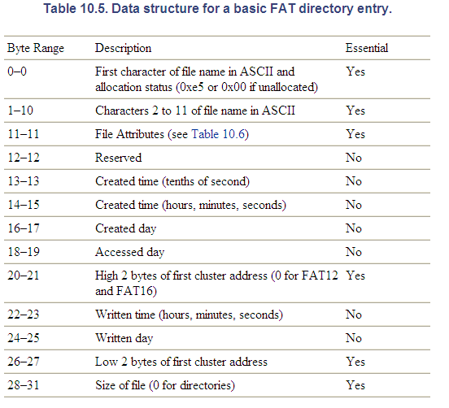
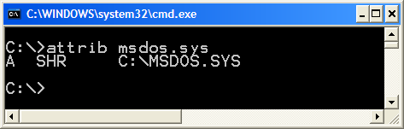
FAT: Root Folder (cont’d)
Data structure for a basic FAT directory entry
8.3 filename
Notes:
Next, let’s take a look at Data structure for a basic FAT directory entry in more detail. Each directory entry has 32 bytes.
[click]
In the FAT file system, the file name is divided into two fields: The first character of the file name, located in the first byte, and the rest of the file name (including from the second byte of the eight-character base filename plus a three-character filename extension at byte offset 8–10. It is also known as 8.3 file names or short file names. The 8.3 file names are stored in ASCII code. Either base filenames or extensions are padded with white spaces (0x20).
You may be wondering why the file name in FAT is designed in such way. The reason for this will become clear when deletion of files is discussed later.
[click]
The next important field at byte offset is File Attributes, contains some security information, which are used by the operating system and other software to determine how a file is accessed and used.
[click]
In Windows, you can use the attrib command to display or set the read-only, archive, system, and hidden attributes of a file or directory. In the example here, the file msdos.sys has all the read-only, archive, system, and hidden attributes set.
[click]
Also, the directory entry contains the first cluster address. It is divided into two fields: its high 2 bytes are located at byte offset 20, and its lower 2 bytes are located at byte offset 26.
[click]
The final 4 bytes at byte offset 28–31 represents the file size in bytes

Slide 32
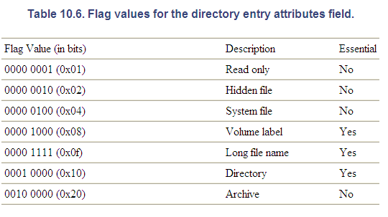
FAT: Root Folder (cont’d)
Flag values for the directory entry attributes field
Table 10.6
Notes:
Next, we look at file attributes in more detail. Basically, file attributes are settings associated with computer files that grant or deny certain rights to how a user or the operating system can access that file. The table here shows the attributes (e.g., Read-only) and their corresponding flag values.
[click]
If the Read-only attribute is set on a file. For example, msdos.sys is read-only file. It means it allows the file to be read, but nothing can be written to the file or changed.
When you use the attrib command to display its attributes. The Read-only attribute will be shown as “R”.
Now you know that the file attributes based on access control in today’s computer is not security. If someone is able to image your hard disk, your security is gone.

Slide 33
8.3 filename, or short-filename, such as “readme01.txt”
What if the file name is expected to be long?
Long file name, such as “readme_CIS6520_2021.txt”
33
Notes:
What if we want to give a file a longer name, for example, readme_CIS6520_2021.txt.

Slide 34
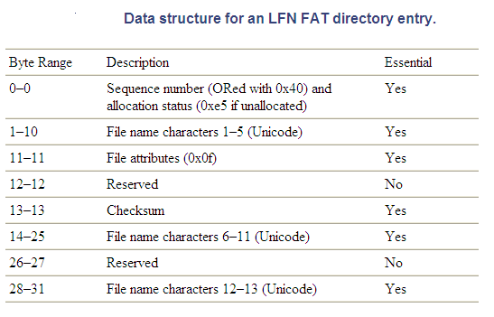
Long File Name Directory Entries
A file will have a normal entry in addition to any long file name (LFN) entries, and the LFN entries will precede the normal entry.
Notes:
The FAT file system uses a concept of long file name (LFN) entry to deal with a file having a long name. A file will have a normal entry in addition to any long file name (LFN) entries, and the LFN entries will precede the normal entry. Note that a long name file can have only one normal directory entry but may have more than one long file name (LFN) entries.
This is Data structure for long file name directory entry. It can be observed that you can store many file name characters in one long file name (LFN) entry.
Note that an LFN entry must have an associated one normal entry (including short filename) because only the normal entry stores the file's starting cluster.

Slide 35
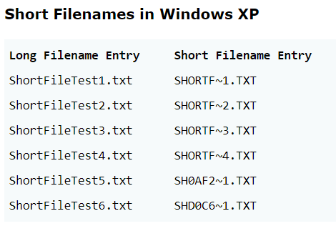
“readme_CIS6520_2021.txt”
……
LFN Entry
Normal Directory Entry
……
Notes:
For example, we have a file called readme_CIS6520_2021.txt. Then, we will need one Normal Directory Entry and one long file name (LFN) entry to store the long file name.
Please note that the LFN entry will precede the normal entry. Also, the normal entry contains a short filename. The way of how an OS creates the short filename varies. However, it is usually created by using the first 6 characters of the filename followed by a tilde (~) and an incremental number.
[click]
This is an example of how a Windows XP-based OS creates short filename. Suppose we create six files in the same directory on a Windows XP system.

Slide 36
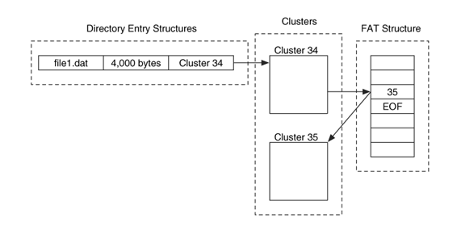
Relationship between the directory entry structures, clusters, and FAT structure.
Part III
File System Category
FAT12 ->12 bits
FAT16 ->16 bits
FAT32 ->32 bits
Metadata
FAT Entry 34
File name
FAT Entry 35
Metadata
File contents
Notes:
The figure here shows an example of a FAT file System as a whole, and describes the relationship between a variety of important data structures in the FAT file system, including the directory entry structure, FAT structure, and data contents organized in clusters.
In this example, a directory entry has a file called “file.dat”. In addition to
the file name, the entry also contains the file size and the address of the first cluster allocated to the file, which Cluster 34. With the address information of the starting cluster, we can locate the corresponding FAT entry (FAT entry 34) whose content is the next cluster allocated for the file, i.e., the second cluster (or Cluster 35) (note that the FAT entry number starts with 0). The FAT entry contains a special signature “EOF”, which marks the end of the file.
As such, we can find out address information for all clusters (or the chain of
clusters) allocated for the file, which are Clusters 34–35. According to this address information, we can determine the physical disk location of these clusters and obtain the file contents stored there.
[click]
As you already know, there are some differences among the different versions of FAT. Another important difference is the size of each FAT table entry.
For FAT12, each FAT entry is 12 bits in size
For FAT16, each FAT entry is 16 bits in size
For FAT32, each FAT entry is 32 bits in size

Slide 37
Dose of Reality:
Cluster address
File Systems
digital storage devices
Partitions
Section address

Slide 38
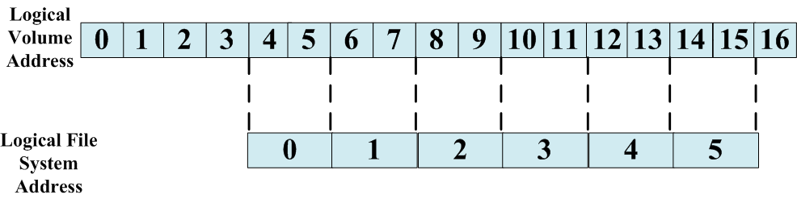
We have to frequently do the conversion between logical volume address and file system addresses
Hard disk
Sector number (address)
cluster/block number (address)
OS
Notes:
We already know that we can use different ways to locate a disk space, for example, using the logical partition volume address, which is a sector number.
Now we start to talk about a file system. The file system allocates disk space in clusters, and a cluster is the smallest unit of disk space that can be allocated to a file. So we have one more addressing scheme to locate a disk space, cluster address or number.
[click]
As such, we have to frequently do the conversion between logical volume address and file system addresses (or cluster address).
[click]
Easy?
[click]
Unfortunately, not, although FAT file system is the simplest one among many file systems available today.

Slide 39

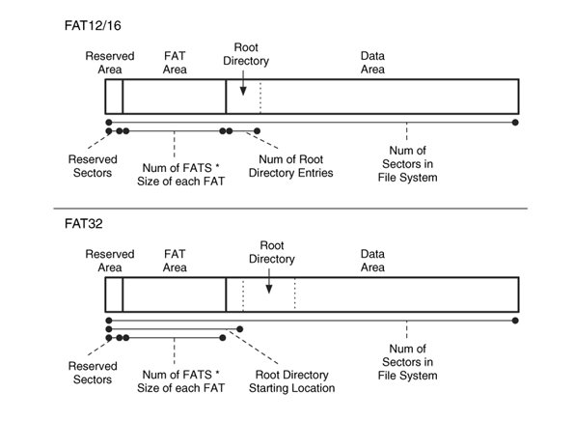
FAT file system layout and data from the boot sector that is used to calculate the locations and sizes.
Notes:
First, you must remember that only disk space in data area has file system addresses (or cluster address) in FAT file systems.
We already know that we can use Partition Boot Sector to figure out FAT file system layout, particularly, the location of data area or where does data area begin?
While we have many different versions of FAT file systems, but the layout of the FAT file systems are very similar.
However, I want to point out one important difference among different versions of FAT file systems:
By design, the root directory in FAT12/FAT16 immediately follows FAT area, which means it is located right behind these FAT tables.
However, in FAT32, the root directory can be located anywhere in the Data Area.

Slide 40
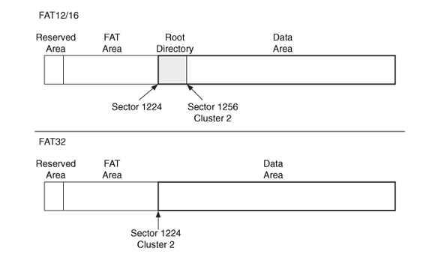
In a FAT12/16 file system, Cluster 2 follows the root directory, and in a FAT32 file system, Cluster 2 is the first data unit of the data area.
The difference is in the location of Cluster 2
Cluster 2
Notes:
In FAT file systems, the data area is divided into clusters which are numbered or addressed from the start of the data area. But, the cluster addresses start at 2. It means the first cluster address is 2 (not using typical Zero-based numbering).
[click]
But there is some difference among different versions of FAT file systems. The difference is in the location of Cluster 2
[click]
Specifically, In a FAT12/16 file system, Cluster 2 follows the root directory, and in a FAT32 file system, Cluster 2 is the first data unit of the data area. Note that a file system groups sectors into larger data units referred to as clusters, or allocation units.

Slide 41
Cluster and Sector Addresses
The basic algorithm for calculating the sector address of cluster C is
(C - 2) * (# of sectors per cluster) + (sector address of cluster 2)
To reverse the process and translate a sector S to a cluster, the following is used:
( (S - sector address of cluster 2) / (# of sectors per cluster) ) + 2
Notes:
The basic algorithms for converting between cluster address and sector address are very simple and straightforward.
Note that the cluster addresses start at 2, which points to the begin of the data area in FAT volume, while sector addresses start at 0, which points to the begin of the partition or FAT volume.
Also, you may pay attention to the location of Cluster 2 when converting between cluster address and sector address.

Slide 42

Cluster 2
These disk space doesn't have a cluster number associated/assigned to them
Notes:
Please note that all the disk space has sector address or logical partition volume address. But these disk space before the data area, shown in the figures, doesn't have a cluster number associated/assigned to them.

Slide 43


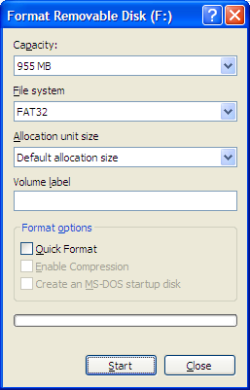
1GB
USB Flash Drive
Notes:
You may still remember when you format a USB drive, you can choose FAT32 as the file system you want to create the USB drive.

Slide 44
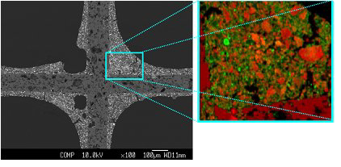
Analysis Techniques for FAT
Notes:
Next, I will use some real examples to discuss some popular analysis techniques for FAT.
It is worth noting many analysis techniques introduced here also work for other file systems, particularly, from the methodological perspective.

Slide 45


File System Layer Analysis
fsstat
Notes:
First, we look at how to analyze file system data. We now introduce a TSK utility, called fsstat. It provides to display the details associated with a file system.

Slide 46
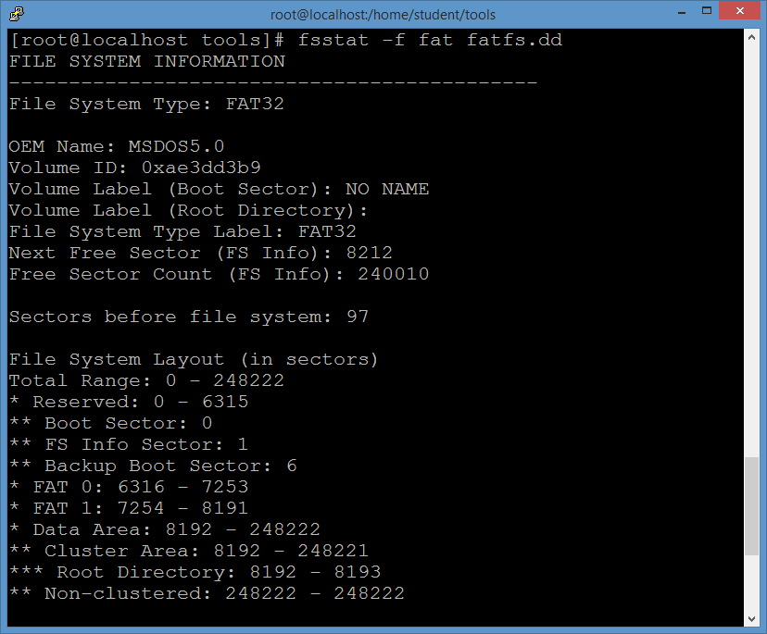
Reserved Sectors
FAT area
Data area
Notes:
This is an example output of the fsstat tool for a FAT file system. It can be seen that fsstat clearly displays the layout of the FAT file system, including three areas, Reserved area, FAT area, and Data area.
For the output, we know that the root directory is located at sectors 8192-8193.
Note that the output of this tool is file system specific.

Slide 47
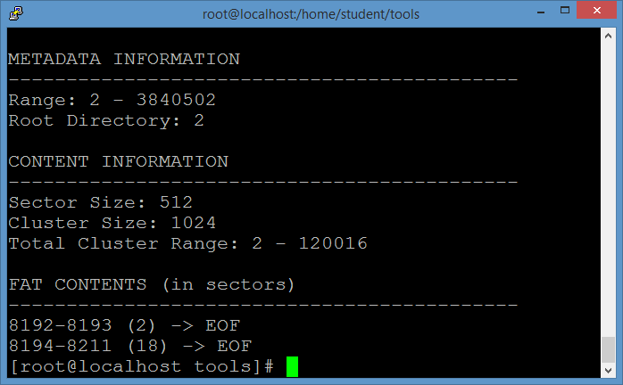
Notes:
Also, we are able to know the sizes of two important data blocks, sector and cluster.

Slide 48

Root Directory
file
Entry 0
folder
Entry 1
Entry 2
……
……
Notes:
We know the location of the root directory, Sectors 8192-8193. Next, we take a look at the root directory in more detail. Each entry represents a file or a subfolder.

Slide 49
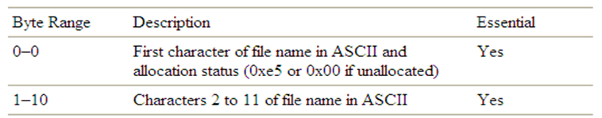
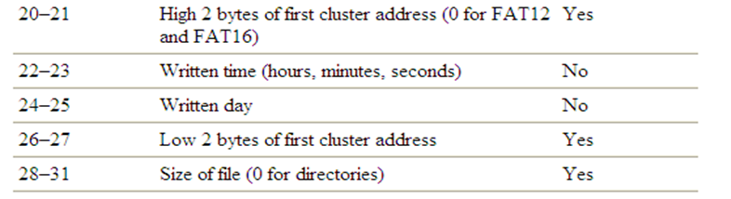
Root Directory (cont’d)
Entry x
file
Notes:
Recall the data structure for a FAT directory entry. Here we only list some import fields which are of interest to us for now. Including, file name, first cluster address, and the file size.

Slide 50
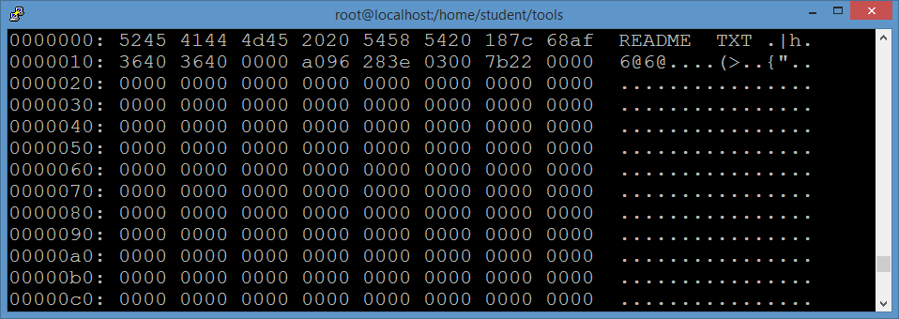
The first cluster address!
0x0000 0003=3
The file size is
0x0000227b=8827 Bytes
Notes:
The figure here shows a hex dump of part of a root directory, using xxd.
Particularly, we take a look at the first directory entry, which has 32 bytes.
[click]
The final 4 bytes in the directory entry is the file size in bytes. So the file size is 8827 Bytes.
[click]
The starting cluster address for the file is divided into two fields: its high 2 bytes are located at byte offset 20, and its lower 2 bytes are located at byte offset 26. So we extract them and put two of them together as one address, which is Cluster 3.
In summary, we now know that the file size is 8827 Bytes, starting at Cluster 3.
But what about other clusters allocated to the file?

Slide 51

File Allocation Table Structure
FAT12 ->12 bits
FAT16 ->16 bits
FAT32 ->32 bits
FAT Entry 34
FAT Entry 35
File contents
Notes:
Recall the relationship between a variety of important data structures in the FAT file system, including the directory entry structure, FAT structure, and clusters. We will need to take a look at FAT structure in order to figure out all clusters (or the chain of clusters) allocated for the file.

Slide 52
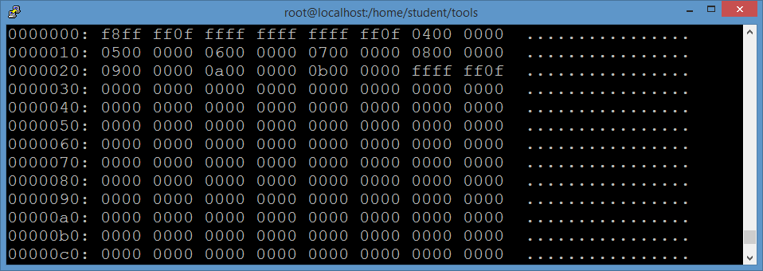
The first cluster of readme.txt is 3
The second cluster!
Notes:
We know that the first cluster of readme.txt is 3.
[click]
So we go to the FAT entry 3 whose content is the next cluster allocated for the file, i.e., the second cluster.
The value stored in the FAT entry 3 is 4, which means the second cluster allocated to the file is Cluster 4.
[click]
This continues until the FAT entry (FAT entry 11)
corresponding to the last cluster is reached. The last FAT entry contains a special signature “0x0fffffff”, which marks the end of the file in FAT32 file system. As such, we can find out address information for all clusters (or the chain of clusters) allocated for the file, which are Clusters 3–11. According to this address information, we can determine the physical disk location of these clusters and obtain the file contents stored there.

Slide 53
File Signature Searching Forensic Technique
md5sum
hfind
[1] Xiaodong Lin. File Signature Searching Forensics: Introductory Computer Forensics: A Hands-on Practical Approach (pp.235-244), 2018
Notes:
Next, we will take a look at another important file system forensics analysis technique, file signature searching forensic technique.

Slide 54


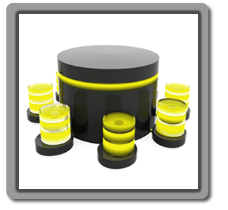



File Signature Searching Forensic Technique (cont’d)
search for a known file based on its signature
Alert
Bad
Hash (or signature) search
hfind
Hash (or signature)
hits
Hard disk image
Good
Alert Database
md5sum
Ignore Database
Ignore
md5sum
Notes:
Particularly, we can create two hash databases using some hash utilities (e.g., md5sum), Alert Database and Ignore Database.
Ignore Database contains good files, such as Windows system files, whereas Alert Database contains bad files, for example, malware.
In order to determine whether a file found in the suspect’s computer is good or bad, we can first compute the hash value of the file and then query two hash Databases using the TSK utility find. If the query is hitting the Alert database, we know it is a bad file.
If the query is hitting the Ignore database, we know it is a good file.

Slide 55
Keyword Searching Forensic Technique
srch_strings
grep
blkcat
ifind
istat
[1] Xiaodong Lin. Keyword Forensics: Introductory Computer Forensics: A Hands-on Practical Approach (pp.245-255), 2018
Notes:
Next, we will take a look at another important file system forensics analysis technique, Keyword Searching Forensic Technique.

Slide 56


Keyword Searching Forensic Technique (cont’d)
search for a known value in each data unit
hits
Hard disk image
View data
Find the meta-data structure
Notes:
So we are talking about a situation where the investigator knows a keyword or value, and wants to know whether the disk used by the suspect contains the keyword. Specifically, we search each data unit for a known keyword or value. After knowing the address of the data unit which contains the keyword.
Then, we can use Data Unit Viewing, for example, using the TSK utility, blkcat to display the content in the data unit or finding out which file occupies the data unit containing the keyword.

Slide 57
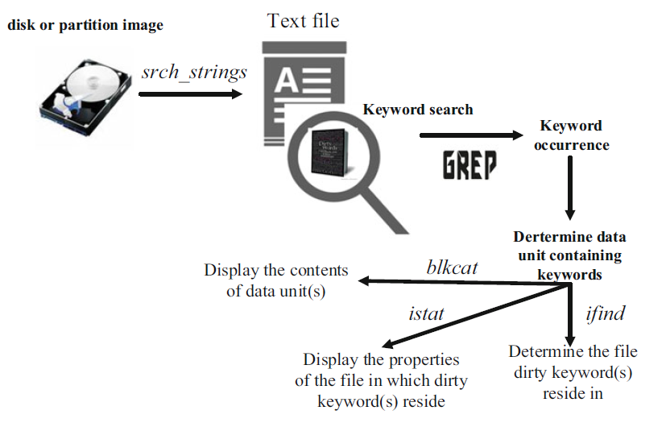
Keyword Searching Forensic Technique (cont’d)
Keyword search process overview
Notes:
The forensic keyword search process typically follows the workflow shown here, where an investigator has a disk image and knows some keyword.
However, it’s a challenge to find a string type keyword when the hard image disk is a bunch of binary data. Therefore, we first need to extract printable data from a binary image disk, for example, using TSK’s srch_strings command, where the .asc file outputted (a text file) is then used to find all the occurrences of keywords. The output .asc file contains all the printable data along with their locations in the disk image. Afterwards, we can search the keyword within the .asc file, for example, using the grep command. If a match is found, the investigator performs further analysis by using TSK utility ifind to find out the meta-data structure for the file that occupies the disk unit where keyword resides or using TSK utility blkcat to display contents of data unit containing keywords. Obviously, after we know the meta-data structure for the file that occupies the disk unit where keyword resides, we can also use TSK utility istat to display details of a given meta-data structure.

Slide 58
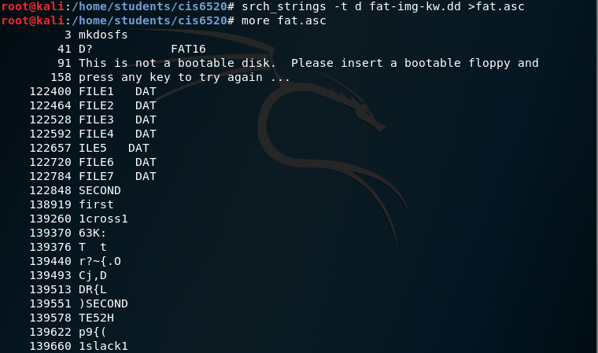

Keyword Searching Forensic Technique (cont’d)
byte offset
Notes:
This is an example of using TSK’s srch_strings command to extract printable data from a binary image disk. We save its .asc file outputted (a text file) to a file.
Note that we are using the "-t d" option here. It means the byte offset of an extracted string is displayed in decimal.
Afterwards, we can search the keyword within the .asc file, for example, using the grep command. If a match is found, the investigator performs further analysis.
In the example here, we find the keyword “first” located in a string starting at byte offset 138919.

Slide 59
Keyword Searching Forensic Technique (cont’d)
Find a suspicious data at byte offset of 1211
1211
Converts between disk unit address (or sector/cluster/block) and byte offset
?
?
?
?
Bytes 0-511
Bytes 512-1023
Bytes 1024-1535
……
Sector 0
Sector 1
Sector 2
1211/512=2.365
=2
Notes:
However, there exists a challenge with finding out the address of sector or cluster which contains the keyword.
[click]
Suppose we find a suspicious keyword at byte offset of 1211 in the .asc file outputted (a text file) from the TSK’s srch_strings command. But, our goal is to find out the address of cluster which contains the keyword.
[click]
So we convert between disk unit address and byte offset
[click]
So we first find out the sector address of disk space where the keyword is stored. Specifically, the byte offset is divided by 512, and we round down the nearest integer of the result and get the sector address.
Note that we calculate the sector address first because the sector addresses start from the begin of the partition, but the cluster addresses may start from somewhere in the partition.
Afterwards, we can find out the address of the cluster where the keyword resides, based on the known sector address.
Note that

Slide 60
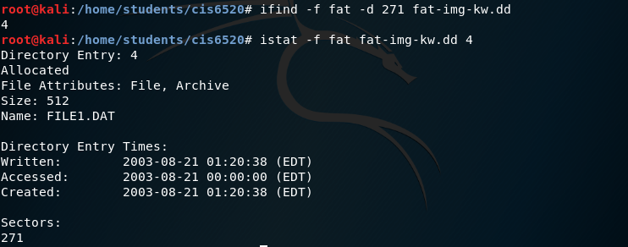
Keyword Searching Forensic Technique (cont’d)
138919/512=271.3
Sector 271
Notes:
Now we know that the keyword is contained in Sector 271.
[click]
Then, we use ifind to find out metadata entry no for a data unit. Note that the TSK tool ifind can also be used to find out metadata entry no for a given file name.
We know metadata entry #4 is associated with the file which contains the keyword.
Finally, we can use the TSK tool istat to display details of the meta-data structure #4.

Slide 61

Recovering Deleted Files based on metadata in FAT File System
hex editor
Notes:
Data recovery is one of the most common techniques in Digital Investigation. Next, let’s take a look at how to recover deleted Files in FAT file system, particularly, we are first talking about the most popular situation, metadata-based deleted file recovery.

Slide 62
What happen to the directory entry structures, clusters, and FAT structure after file deletion
wipe out all FAT entries
0
0
the first character of the file name is replaced by a special character (0xE5).
Notes:
First, we will study file deletion behavior in FAT file system. When a file is deleted in a FAT file system, the operating system only updates the
DIR entry where the first character of the file name (or the first byte of the directory entry) is set to a special character (0xe5 in hex). The directory entry becomes a deletion entry. The character 0xE5 indicates to the system that the directory entry is available for use by a new entry, but no other change is made to this directory entry. In other words, the rest of the file name as well as meta-data (the file size, and most importantly the address of the starting cluster for the file)
is kept intact.
At the same time, all the FAT entries corresponding to the deleted file are zeroed out to indicate that the corresponding clusters are available for use.
However, the operating system does not erase the actual contents of the data clusters.
Obviously, it is very straightforward to recover deleted files by using remaining file metadata information in a FAT file system given that most of files are stored in contiguous blocks. First, we scan the entire file system one directory entry at a time and compile a list of entries with a deletion marker (e.g. 0xE5). Then, we simply change the first character of the file name back to its original one from 0xE5. Then, we put back the cluster chain into FAT since we know the starting cluster address from the DIR entry as well as the file is stored on consecutive disk blocks.

Slide 63

File Allocation Table 0
We only alter data in few small areas (root directory and FAT)
Original Image
0-248222 (248223 sectors)
First 6316 sectors
1875 sectors
last 240030 sectors
Root Directory
Modified Image
First 6316 sectors
1875 sectors
last 240030 sectors
63
Notes:
In order to recover a deleted file in FAT file system, we have to modify several areas. However, in practice, we need to work on a disk image, which could be very large. It is hard to edit the whole image file.
In reality, we only need to edit a small disk area. Therefore, a good approach is to locate the area which we will work on, and then extract and save it into a small image file.
[click]
Afterwards, we can edit the small image file and make any necessary changes for file recovery.
[click]
Once all changes are complete, we can create a new disk partition image by integrating two images.

Slide 64
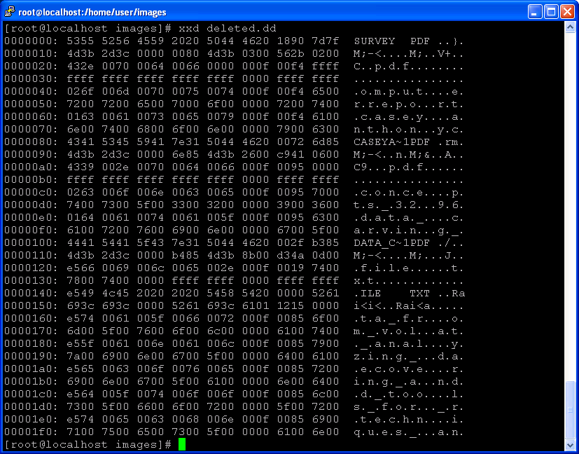
Deleted file.txt
How many clusters are allocated to this file? (if the cluster size is 4096)
The first cluster address!
0x0161=353
The file size is
0x00001512=5394
64
Notes:
Next, we will use a real example to show how to recover a deleted file in FAT file system step by step.
There are some important information you will have to figure out in order to successfully recover a deleted file in FAT file system.
[click]
First, you locate a deletion entry
[click]
Then you can figure out the file size, which is 5394 bytes in the example.
[click]
Then, based on the cluster size, you can find out the number of clusters allocated to the deleted file, which is 2 clusters.
[click]
Also, you can find out the starting cluster occupied by the deleted file.

Slide 65

The first character from 0xE5 to “F”
65
Notes:
In order to recover the deleted file, we first change the first character of the file name back to its original one from 0xE5. In reality, you may not know the first character of the file name, and actually, any printable letter should work.

Slide 66

FAT
FAT 0 starts at sector 6136
Each entry has 32bits=4 bytes
FAT Entry 0
FAT Entry 1
FAT Entry 2
Cluster 2
……
What is there?
What is there?
FAT Entry 353
FAT Entry ?
Cluster 353
FAT Entry 354
FAT Entry ?
Cluster 354
……
354=0x00000162
We know the cluster addresses
0x0fffffff
66
Notes:
Then, we will put back the cluster chain into FAT. Note that we use FAT32, so each FAT entry has 32 bits or 4 bytes.
Since we know the starting cluster address, which is Cluster 353 and the file occupies two clusters. Also, please note that we assume the file is stored on consecutive disk blocks. So we know the file occupies Clusters 353 and 354.
[click]
So we put back the cluster chain into FAT. Technically speaking, we go to FAT entries 353 and 354. The most important thing is to figure out the values stored in these FAT entries.
The values are supposed to the address of next cluster for the FAT entry associated to.
[click]
Obviously, the value for the FAT entry 353 is 354.
[click]
However, Cluster 354 is the last cluster allocated to the file. So we need to put the End-of-file signature, which is “0x0fffffff” for the FAT32 file system.

Slide 67
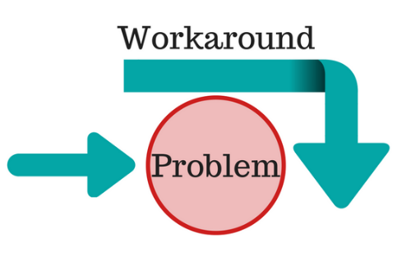

File Allocation Table 0
We can also simply extract file content in the Data Area
Original Image
0-248222 (248223 sectors)
First 6316 sectors
1875 sectors
last 240030 sectors
Root Directory
A file
67
Notes:
Since we are able to figure out the location of the file, i.e. all the clusters allocated to the file. Another simple way is to extract file content in the Data Area and save them into another file.
Note that when you read the last cluster allocated to the file, you must only read the content belonging to the file and remove the slack space based on the file size.

Slide 68

Reading materials
Chapters 5, 6, 10, 11
Andrea Fortuna, Some thoughts about FAT Filesystem.
https://www.andreafortuna.org/2017/10/04/some-thoughts-about-fat-filesystem/

